Slide 1
Notes:
http://gregtatum.com/interactive/2014/recursivity-2-branching/

Slide 2
Notes:
https://gifer.com/en/2M8j

Slide 3
Notes:
http://tysonibele.com/tree-rigger/

Slide 4
Notes:
https://www.tes.com/teaching-resource/fractal-trees-11676695

Slide 5

Notes:
https://vimeo.com/209404374

Slide 6

Notes:
https://www.youtube.com/watch?v=qo46wLyqOr8

Slide 7
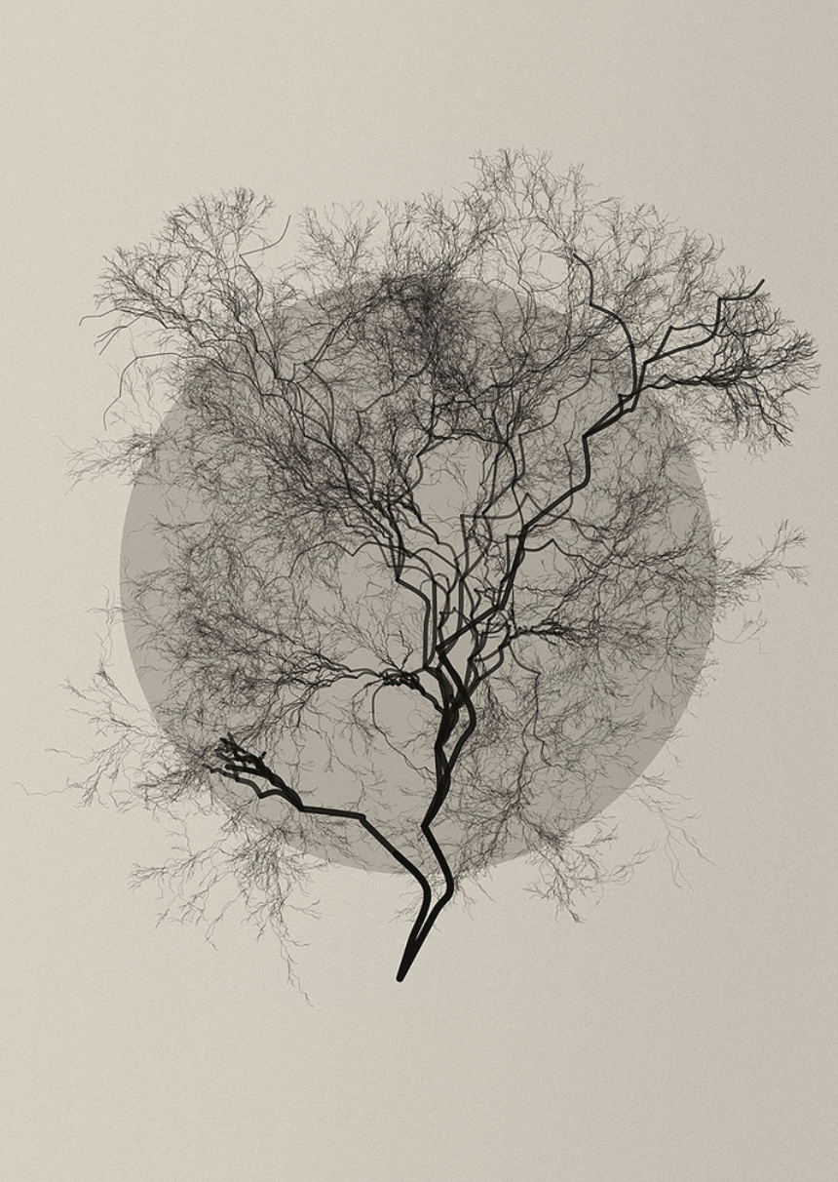
Notes:
https://www.flickr.com/photos/dianalange/6830934130/

